Slide 1
System Programming
Sockets

Slide 2
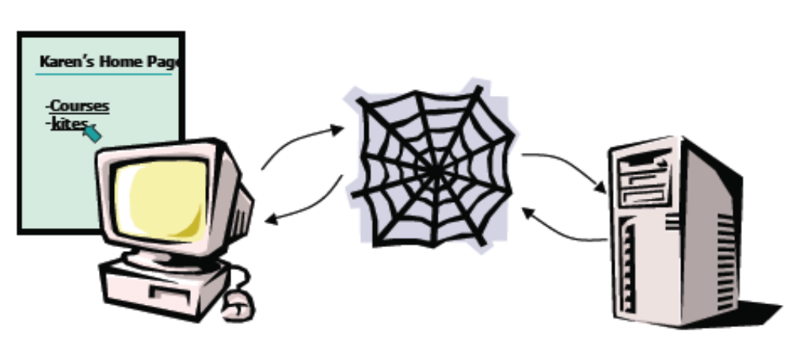
Simple Web Request

Slide 3
How do we find the server?
Every computer on the Internet has an Internet address.
Called an IP address (Internet Protocol)
An IP address is 4 8-bit numbers separated by dots.
www.ktu.edu.tr = 193.140.168.225

Slide 4
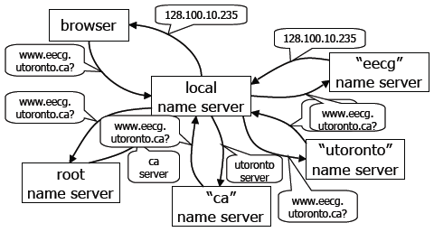
Domain Name Servers

Slide 5
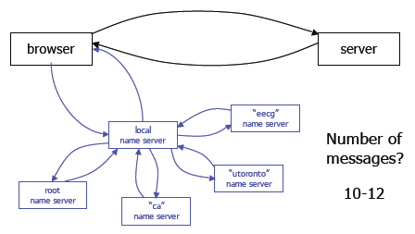
This is getting complicated!

Slide 6
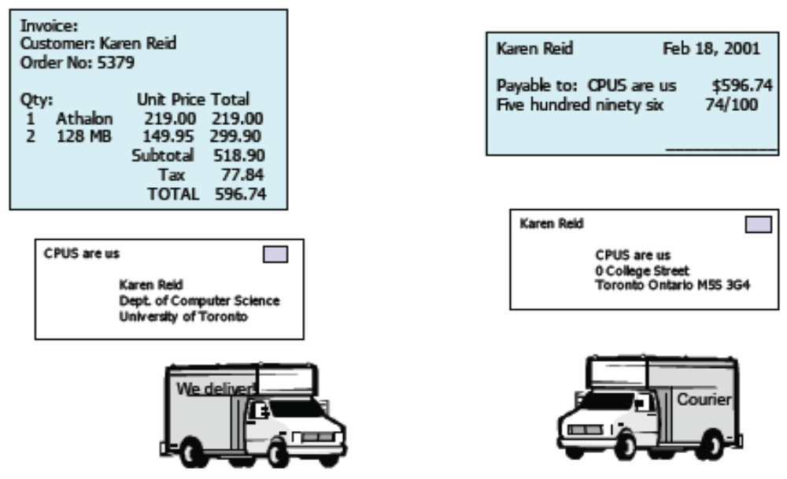
Protocols

Slide 7
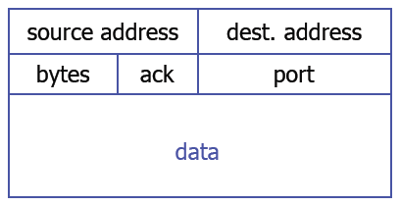
TCP/IP
Transmission Control Protocol.
Tells us how to package up the data.

Slide 8
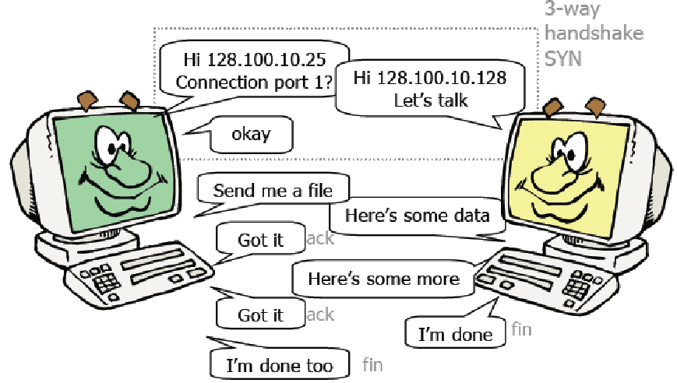
TCP Connection

Slide 9
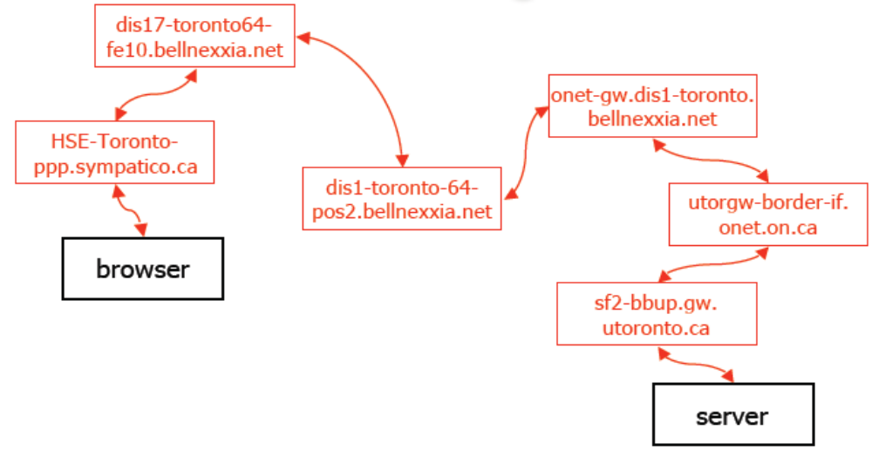
Routing

Slide 10
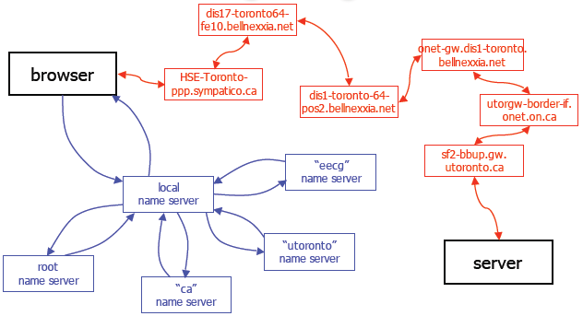
Putting it together

Slide 11
How many messages?
It depends on the size of the web page we retrieve.
If the web page is 75 Kbytes (small!) it will be broken up into 103 IP packets.
Remember DNS took 10 messages
10 + 103 x 7 hops = 731 messages!

Slide 12
Sockets
One form of communication between processes.
Similar to pipes, except sockets can be used between processes on different machines.
Use file descriptors to refer to sockets.
Built on top of TCP layer

Slide 13
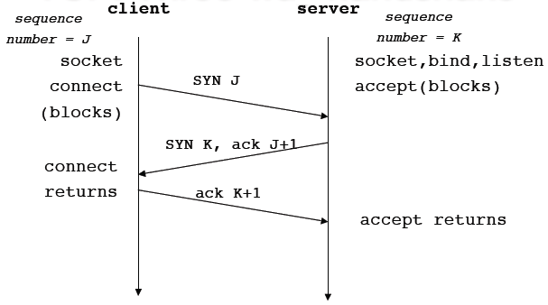
TCP: Three-way handshake

Slide 14
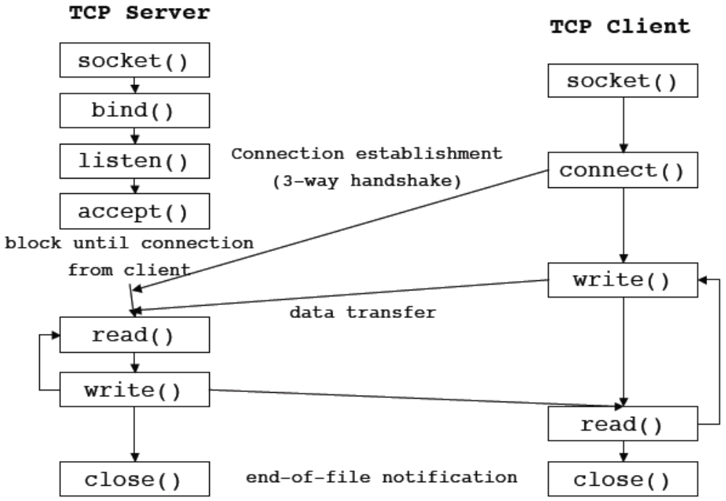

Slide 15
Connection-Oriented
Server
  Create a socket: socket()
  Assign a name to a socket: bind()
  Establish a queue for connections: listen()
  Get a connection from the queue: accept()
Client
  Create a socket: socket()
  Initiate a connection: connect()

Slide 16
Socket Types
Two main categories of sockets
  UNIX domain: both processes on the same machine
  INET domain: processes on different machines
Three main types of sockets:
  SOCK_STREAM: the one we will use
  SOCK_DGRAM: for connectionless sockets
  SOCK_RAW

Slide 17
Addresses and Ports
A socket pair is the two endpoints of the connection.
An endpoint is identified by an IP address and a port.
IPv4 addresses are 4 8-bit numbers:
  128.100.31.156 = penguin
  128.100.31.4 = eddie
Ports
  because multiple processes can communicate with a single machine we need another identifier.

Slide 18
More on Ports
Well-known ports: 0-1023
  80 = web 21 = ftp
  22 = ssh 25 = smtp (mail)
  23 = telnet 194 = irc
Registered ports: 1024-49151
  2709 = supermon
  26000 = quake
Dynamic (private) ports: 49152-65535
  You should pick ports in this range to avoid overlap

Slide 19
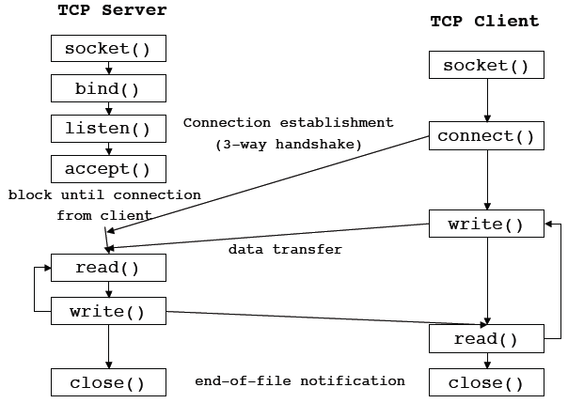

Slide 20
Server side
int socket(int family, int type,
int protocol);
family specifies protocol family:
  PF_INET – IPv4
  PF_LOCAL – Unix domain
type
  SOCK_STREAM, SOCK_DGRAM, SOCK_RAW
protocol
  set to 0 except for RAW sockets
returns a socket descriptor

Slide 21
bind to a name
int bind(int sockfd,
const struct sockaddr *servaddr,
socklen_t addrlen);
sockfd – returned by socket
struct sockaddr_in{
short sin_family; /*PF_INET */
u_short sin_port;
struct in_addr sin_addr;
char sin_zero[8];
}
sin_addr can be set to INADDR_ANY to communicate with any host

Slide 22
Set up queue in kernel
int listen(int sockfd, int backlog)
after calling listen, a socket is ready to accept connections
prepares a queue in the kernel where partially completed connections wait to be accepted.
backlog is the maximum number of partially completed connections that the kernel should queue.

Slide 25
Complete the connection
int accept(int sockfd,
struct sockaddr *cliaddr,
socklen_t *addrlen);
blocks waiting for a connection (from the queue)
returns a new descriptor which refers to the TCP connection with the client
  sockfd is the listening socket
  cliaddr is the address of the client
reads and writes on the connection will use the socket returned by accept

Slide 26
Client side
socket() – same as server, to say “how” we are going to talk
int connect(int sockfd,
const struct sockaddr *servaddr,
socklen_t addrlen);
the kernel will choose a dynamic port and source IP address.
returns 0 on success and -1 on failure setting errno.
initiates the three-way handshake.

Slide 27
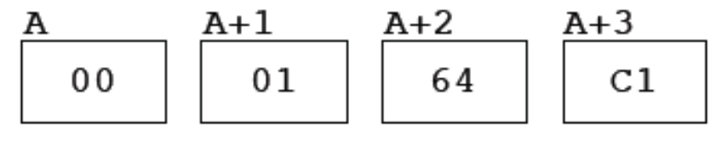

Byte order
Big-endian
91,329 =
Little-endian
91,329 =
Intel is little-endian, and Sparc is big-endian

Slide 28
Network byte order
To communicate between machines with unknown or different “endian-ness” we convert numbers to network byte order (bigendian) before we send them.
There are functions provided to do this:
  unsigned long htonl(unsigned long)
  unsigned short htons(unsigned short)
  unsigned long ntohl(unsigned long)
  unsigned short ntohs(unsigned short)

